Slide 1
Data-Driven Anti-Money Laundering: A Machine Learning Framework
Mentor | Anthony T.C. Tam
Student 1 (Leader) | Deng Dezhao
Student 2 | Yu Caili
Student 3 | Wang Yujin
Student 4 | Yan Chenyue

Slide 2
Introduction of Past Work
Basic components
Performance & method
multi-classification model
Introduction of Future Work
Temporal Graph Network

Slide 3
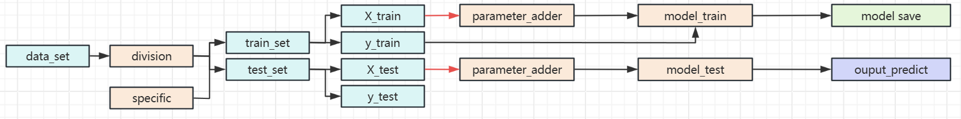
Our current direction: using XGBoost with temporary graph feature engineering
Model training pipeline
Model implement pipeline
At present, the running time in param_a mode is within ten minutes (SAML-D.csv, October 2022~August 2023, 30000 transactions per day, using a 7-day window).
In order to unify the input, the model also requires ColumnTransformer to handle the types of parameters

Slide 4
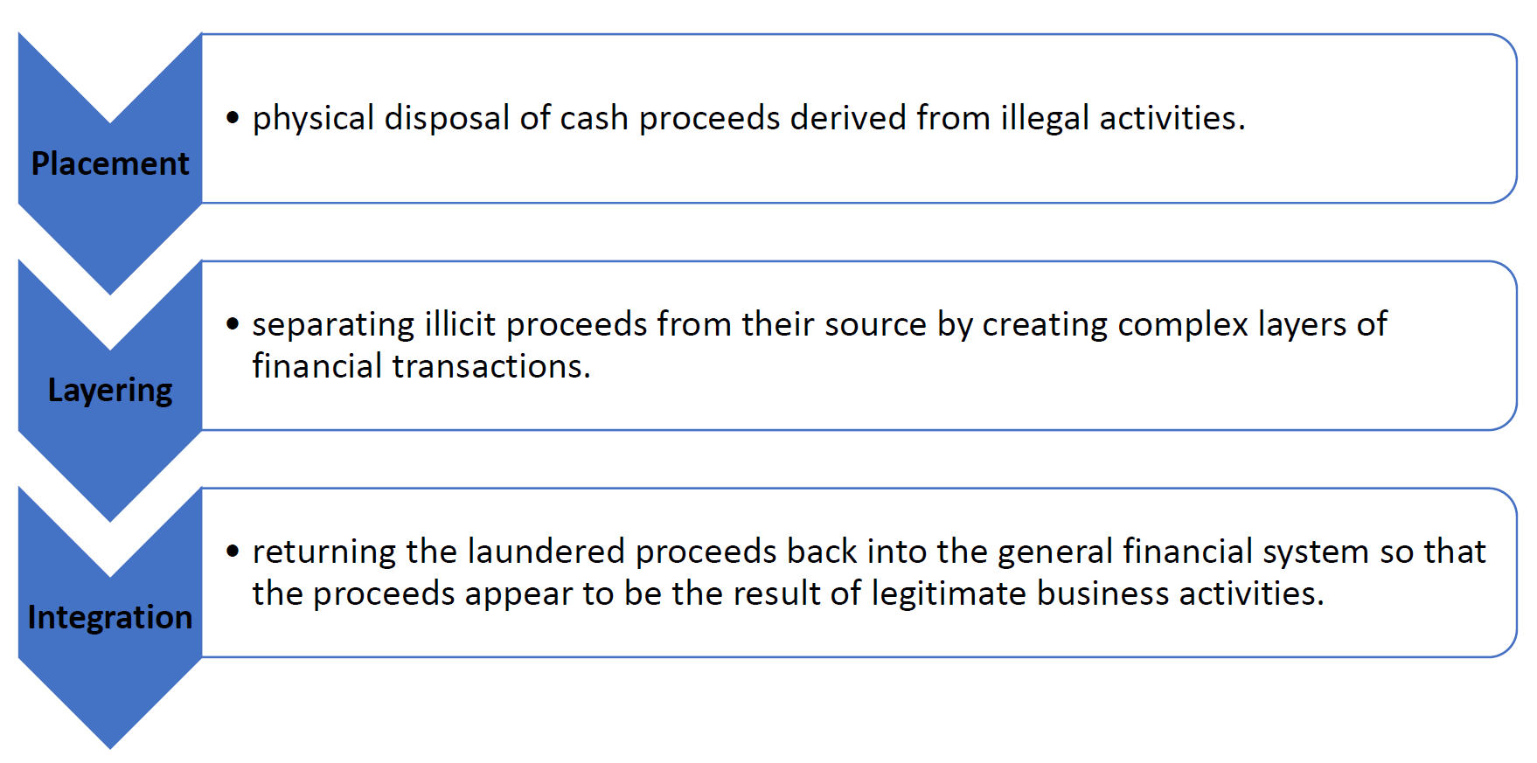

The Graph is a description of the money laundering process
t=13, 5$
t=15, 7$
t=23, 7$
t=3, 5$
t=1, 2$
t=18, 20$
t=11, 10$
t=19, 5$
There are three layers of money-laundering
Graph is a network

Slide 5

Historical patterns + deeper contextual information + connections between accounts
Same boss
For example, let's say that a customer, John Doe, is trading a series of low-value cash deposits, each just below the $10,000 threshold, spread across accounts that appear to belong to different businesses, such as “John's Appliances” and “Doe's Electric”
At first glance, these transactions appear to be legitimate and the entities are not connected to each other
However, an anti-financial crime investigator who understands the local business environment and customer behavior is likely to be alerted to the fact that the two businesses have the same owner and are located in close proximity to each other

Slide 6
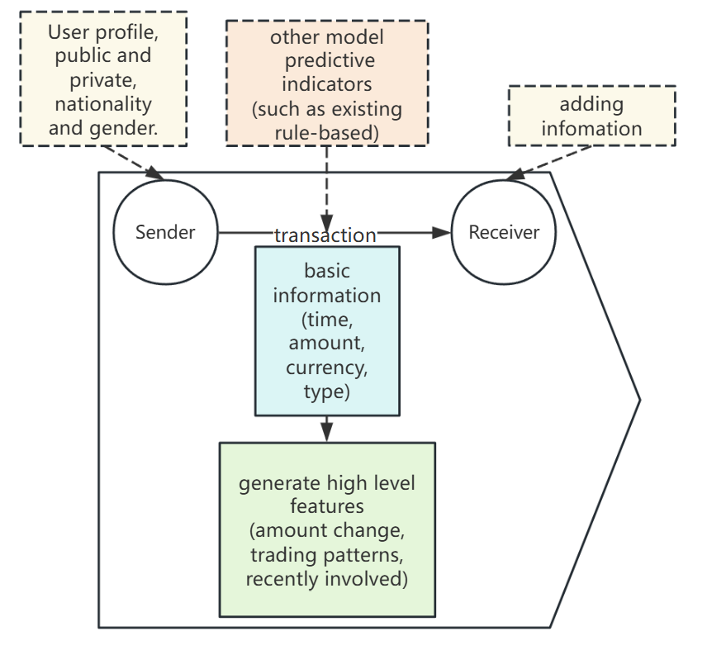
The graph structure can synthesize the transaction network structure, rule information, and customer background
This is what we generate for each transaction

Slide 7

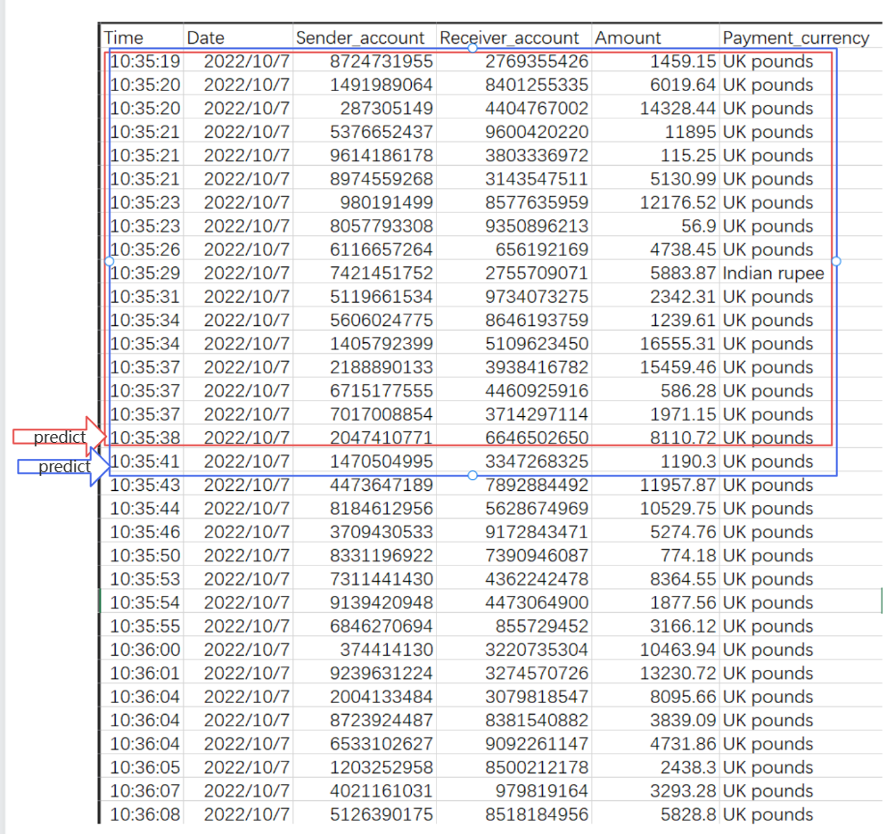
We want to see how money flows through the network
We use temporal graphs for feature engineering

Slide 8
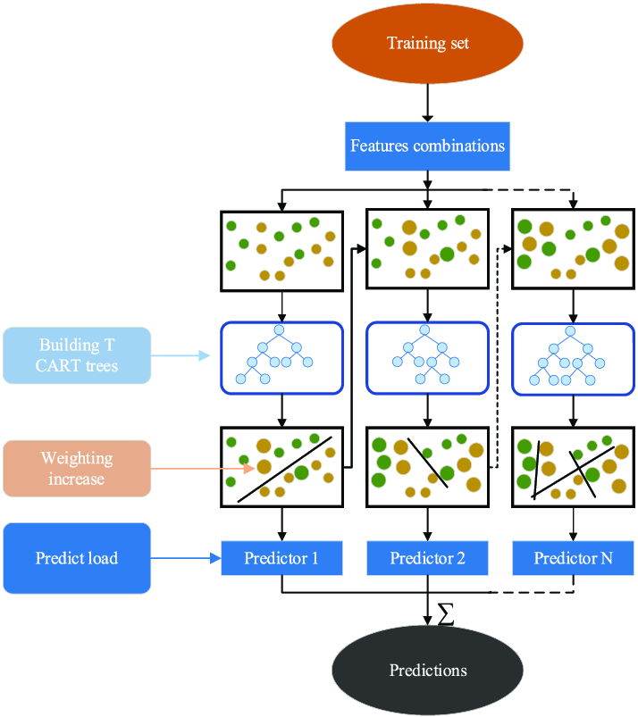
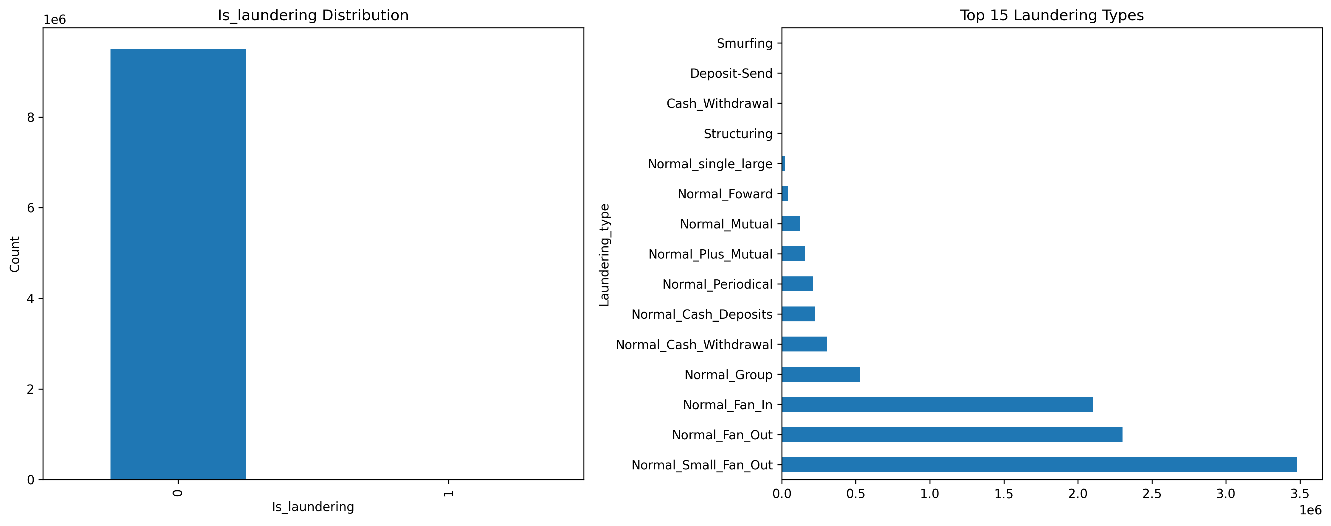
Using the random sampling nature of XGBoost to avoid the problem of small learning samples
XGBoost, which can be considered as an optimized random forest (decision tree).
Limited learning examples of money laundering activity

Slide 9
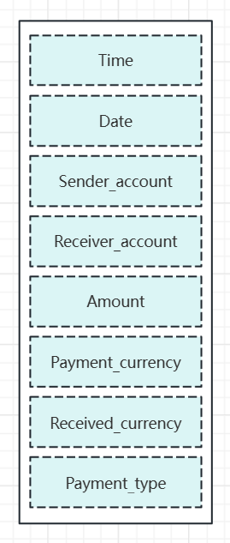
We are currently only exploring the enhancement of transaction results for predicting AML activity
raw parameters we use

Slide 10
Total feature we generaate currently
Specific feature columns:
['Sender_send_amount', 'Sender_send_count', 'Sender_send_frequency',
'Receiver_receive_amount', 'Receiver_receive_count', 'Receiver_receive_frequency',
'Sender_receive_amount', 'Sender_receive_count', 'Sender_receive_frequency',
'Receiver_send_amount', 'Receiver_send_count', 'Receiver_send_frequency’,
'sender_account_degree_centrality', 'sender_account_closeness_centrality',
'sender_account_betweenness_centrality', 'receiver_account_degree_centrality',
'receiver_account_closeness_centrality', 'receiver_account_betweenness_centrality’]
It is recommended to control the trading volume within 200000, including within the window.

Slide 11
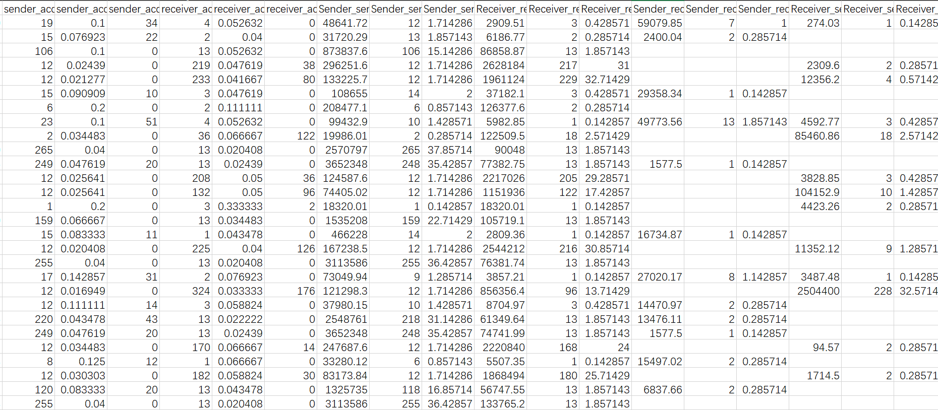
Take a glance of the specific feature columns

Slide 12
Introduction of Past Work
Basic components
Performance & method
multi-classification model
Introduction of Future Work
Temporal Graph Network

Slide 13
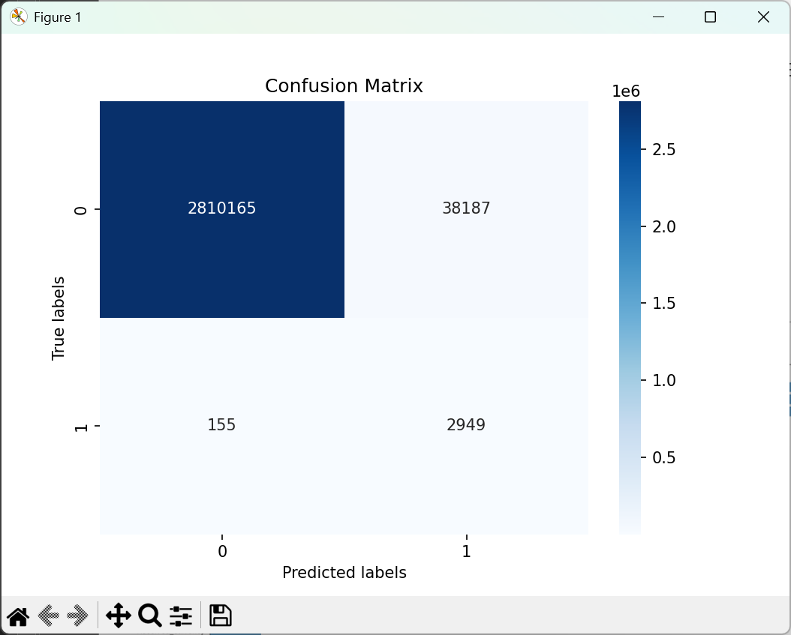
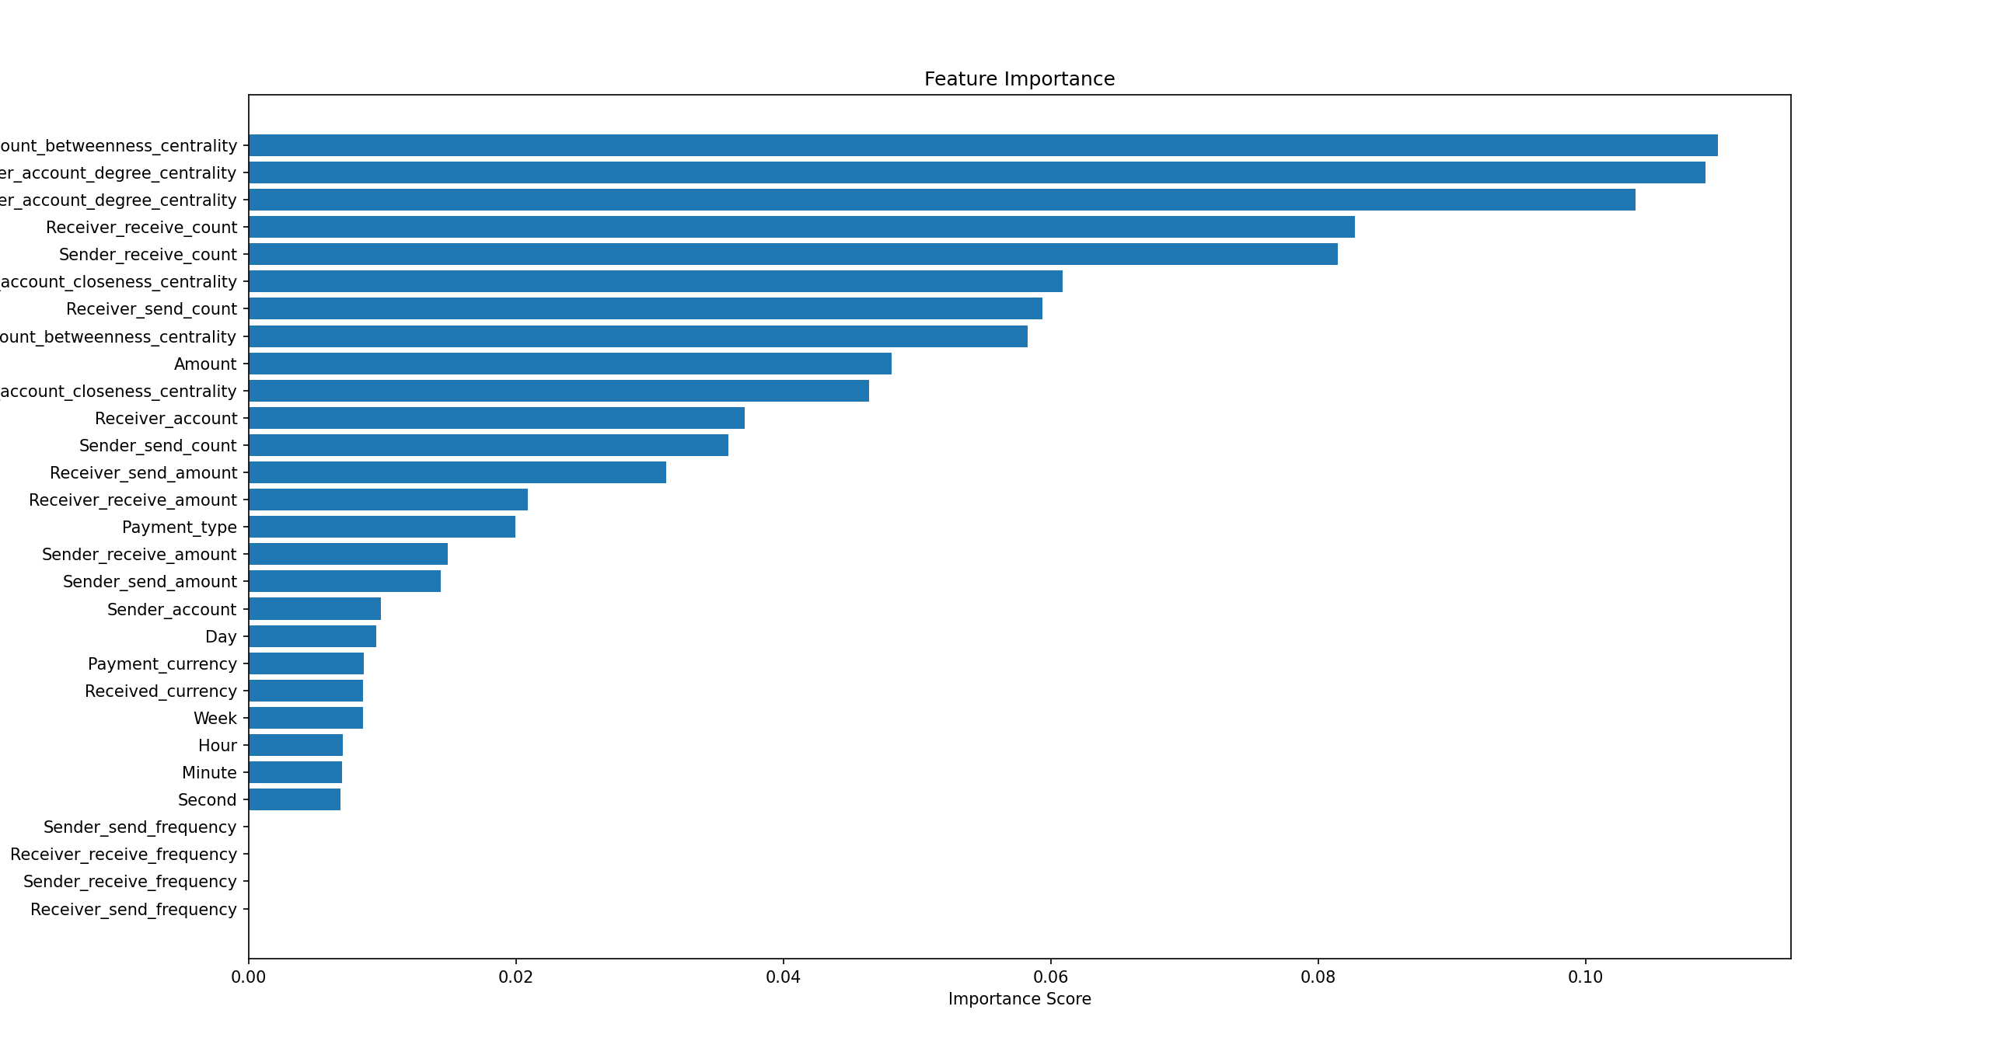
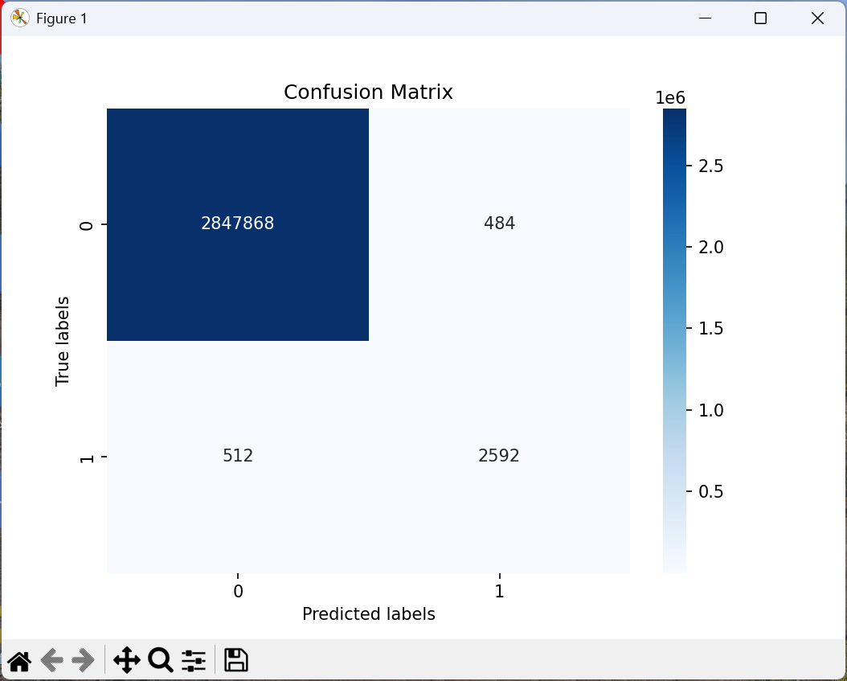
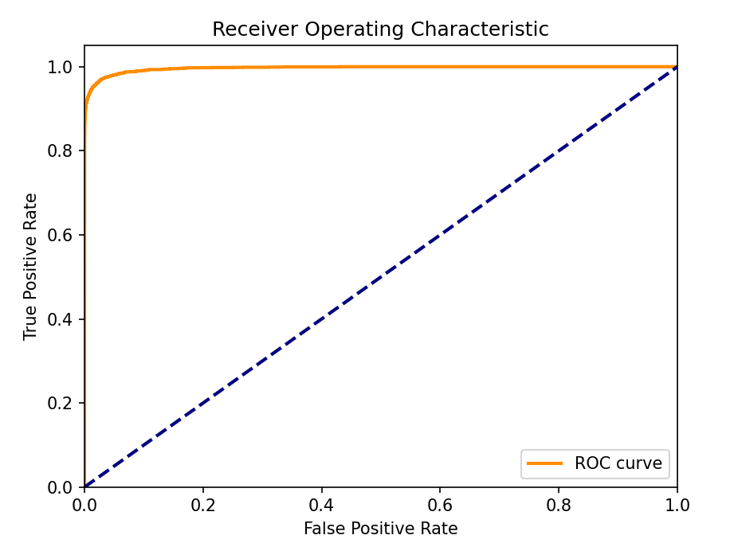
TPR = 95%, window size =10
Accuracy = 99% TPR = 95% FPR = 1%
TPR = 83% FPR = 0.016%
Currently:
Taking 70% training and 30% testing samples from the entire SAML dataset
while adding all our features.
'Sender_send_amount', 'Sender_send_count', 'Sender_send_frequency',
'Receiver_receive_amount', 'Receiver_receive_count', 'Receiver_receive_frequency',
'Sender_receive_amount', 'Sender_receive_count', 'Sender_receive_frequency',
'Receiver_send_amount', 'Receiver_send_count', 'Receiver_send_frequency’,
'sender_account_degree_centrality', 'sender_account_closeness_centrality',
'sender_account_betweenness_centrality', 'receiver_account_degree_centrality',
'receiver_account_closeness_centrality', 'receiver_account_betweenness_centrality'
TPR = 83%

Slide 14
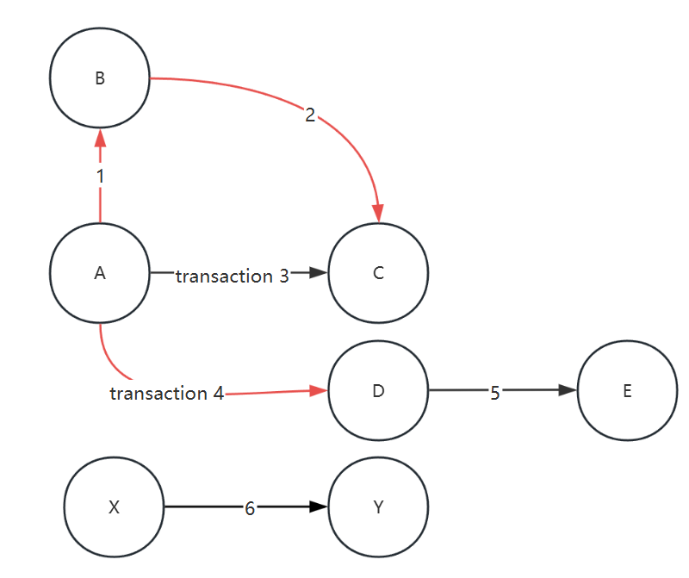
We use sliding window to get features of temporary graph
Sender account | Receiver account
A | B
B | C
A | C
A | D
D | E
X | Y
Simple example for Graph features
Use previous transactions of the related account
But time consumed (calculated once for each transaction)
We can get graph features
Degree Centrality: {'A': 0.5, 'B': 0.33, 'C': 0.33, 'D': 0.33, 'E': 0.16, 'X': 'Y': 0.16}
Closeness Centrality: {'A': 0.0, 'B': 0.16, 'C': 0.33, 'D': 0.16, 'E': 0.22, 'X': 0.0, 'Y': 0.16}
Betweenness Centrality: {'A': 0.0, 'B': 0.0, 'C': 0.0, 'D': 0.03, 'E': 0.0, 'X': 0.0, 'Y': 0.0}

Slide 15
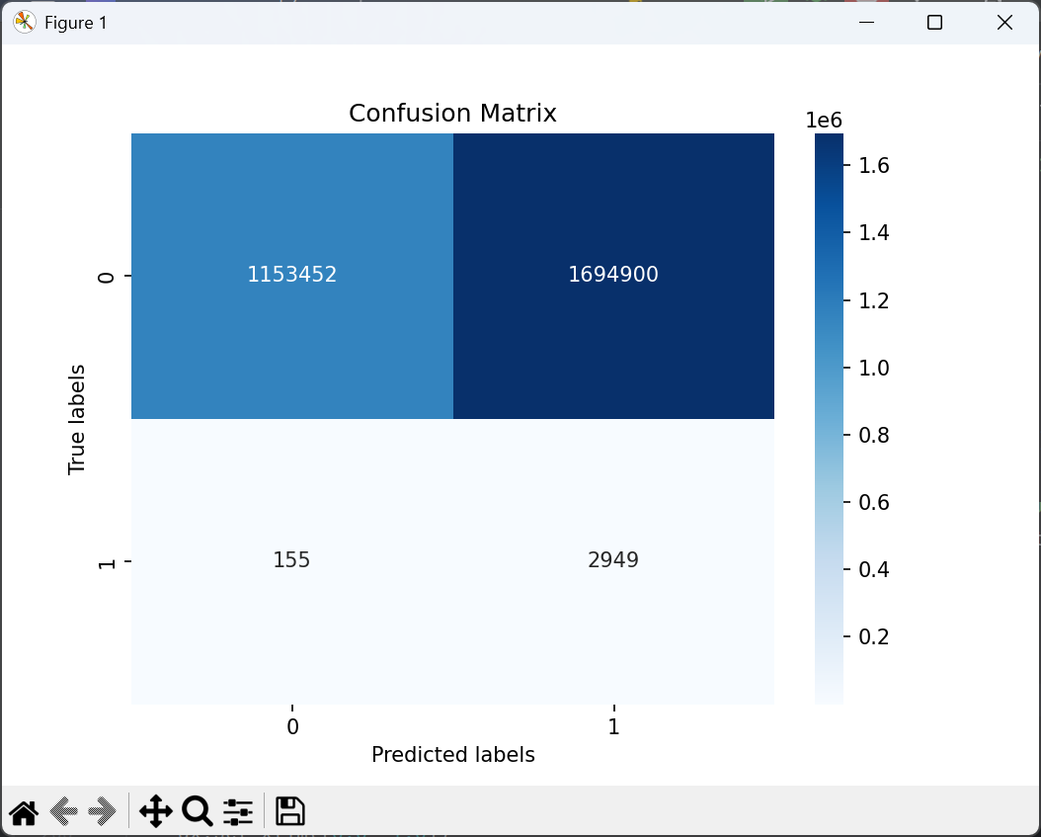
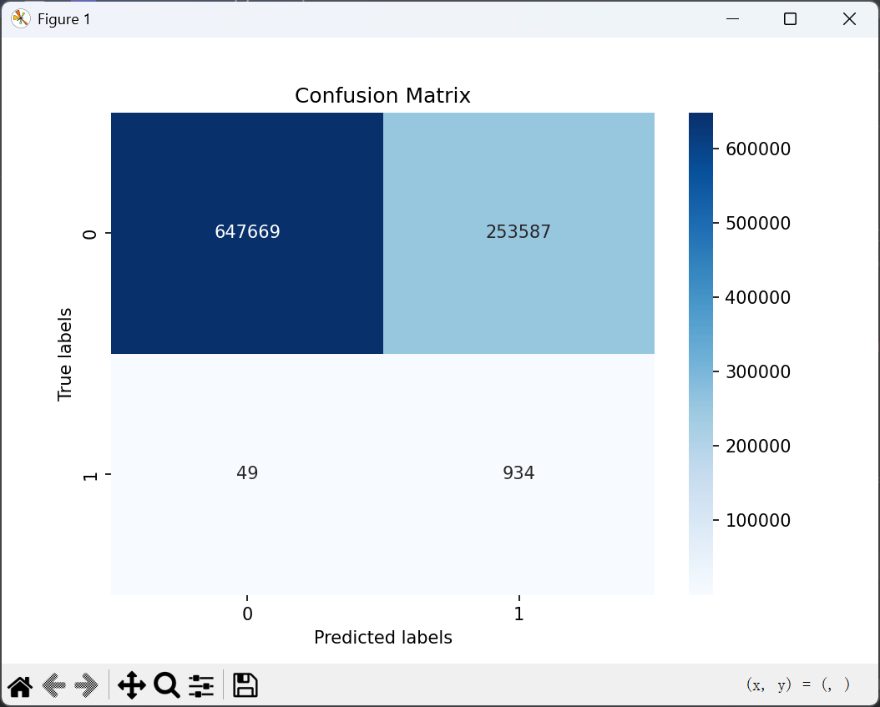
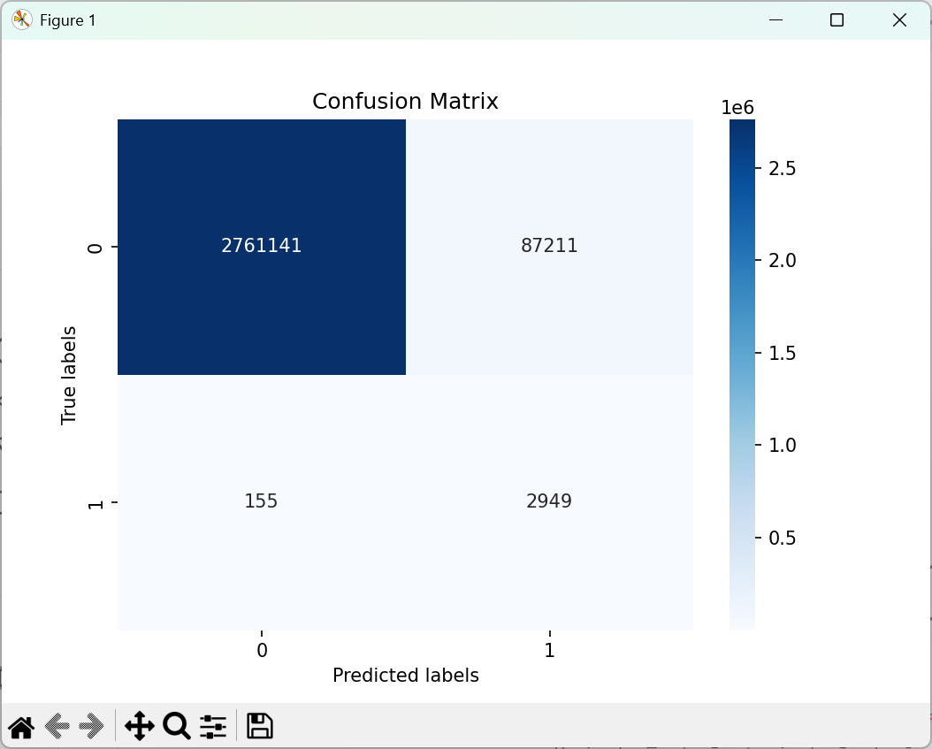
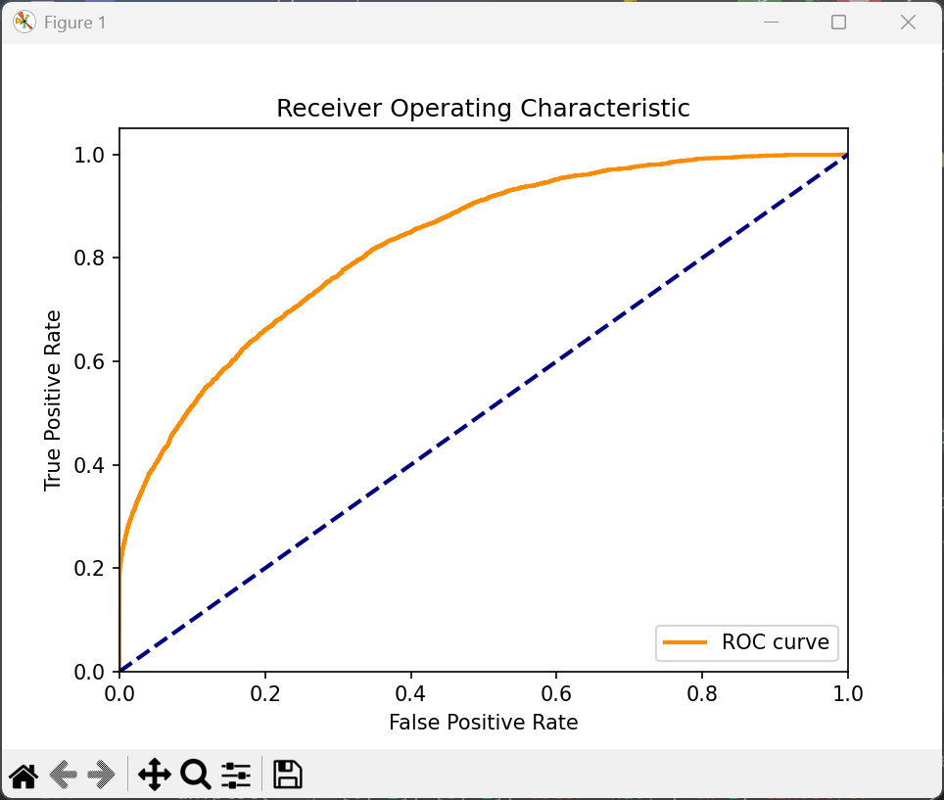
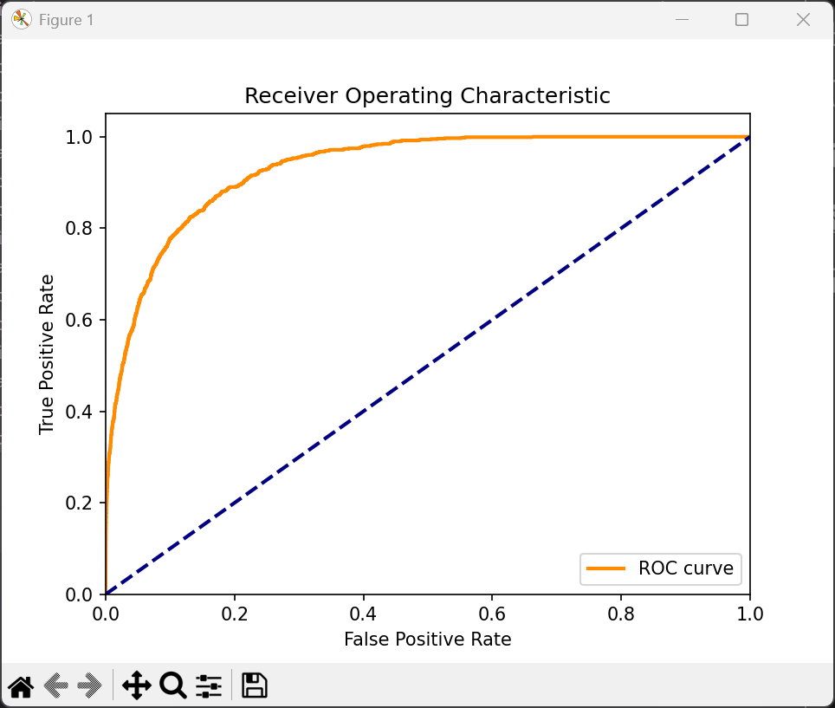
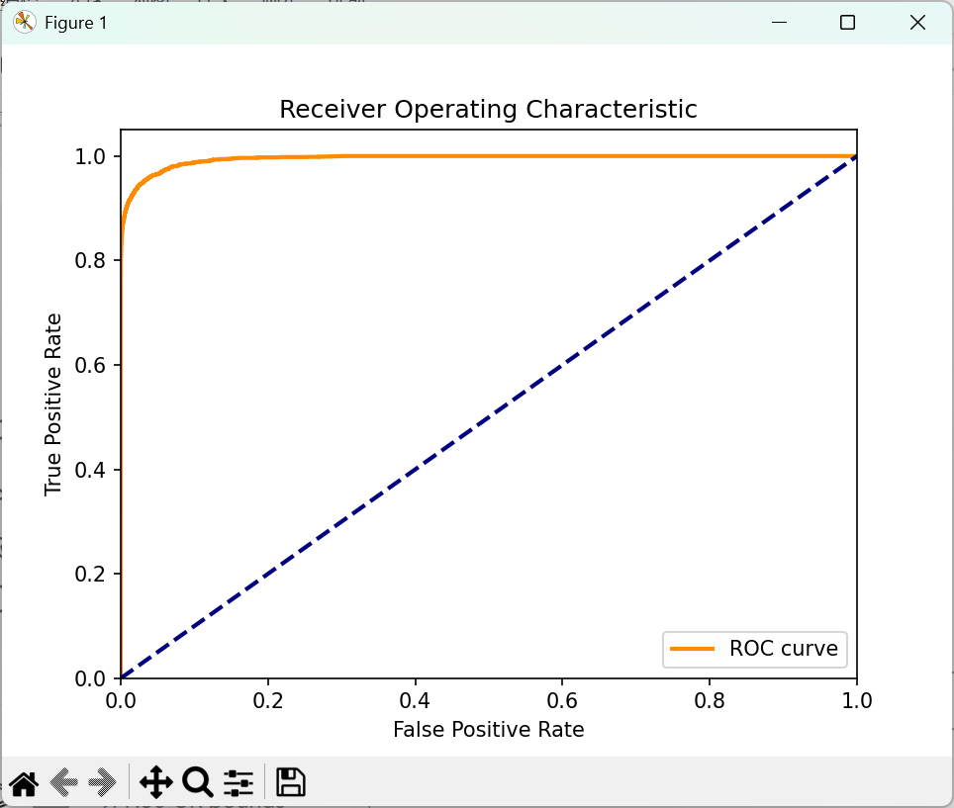
Graph feature engineering can improve the performance even little graph features can strengthen the predictions
TPR =95%, window size =7
None feature
With limited basic features
Basic features &Graph features

Slide 16
Feature Engineer in real case, how to balance computing time and prediction quality
Each transaction feature depends on other nearby transactions, taking into account the recent transactions of the sender and receiver
Definition of nearby dependent windows:
1. At the beginning, we ignored the concept of the future and counted all transactions involving the sender and receiver in the training set
2. When only one transaction at the arrow is filled in as shown in the figure, the dataset needs to be split once and then computed once. More than 30000 pieces of data are needed in just one day.
Notes:
Definition of nearby dependent windows:
At the beginning, we ignored the concept of the future and counted all transactions involving the sender and receiver in the training set
2. strictly follows the rule of only reading data before the current transaction
3.But it's like stopping every transaction, counting recent transactions and possibly creating a network diagram. Very time-consuming. When only one transaction at the arrow is filled in as shown in the figure, the dataset needs to be split once and then computed once. More than 30000 pieces of data are needed in just one day.

Slide 17
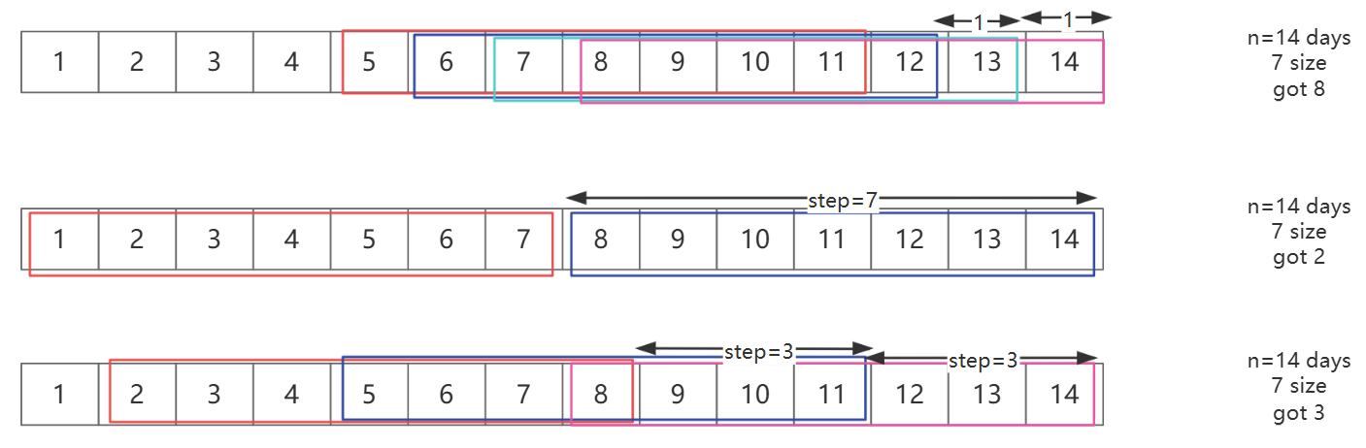
Adjust the window size and sliding step to balance efficiency and quality.
Step=1
The closest to strict historical trading.
Step=size
Same to simple cut when size=step
Step=size/2
(n-size)/step + 1

Slide 18
The Longer computing time , the better prediction
FPR | 1(step1) | 3(step1) | 3(step3) | 5(step1) | 5(step3) | 5(step5) | 7(step1) | 7(step4) | 7(step7) | 10(step1) | 14(step1) | 15(step1) | 16(step1) | 17(step1)
Basic features | 0.277 | 0.195 | 0.190 | 0.164 | 0.181 | 0.173 | 0.137 | 0.189 | 0.148 | 0.083 | 0.058 | 0.081 | 0.057 | 0.053
Graph features | 0.266 | 0.134 | 0.146 | 0.116 | 0.099 | 0.113 | 0.068 | 0.113 | 0.065 | 0.054 | 0.021 | 0.028 | 0.023 | 0.016
Both features | 0.276 | 0.125 | 0.134 | 0.088 | 0.117 | 0.110 | 0.064 | 0.110 | 0.082 | 0.035 | 0.014 | 0.010 | 0.012 | 0.011
AUC | 1(step1) | 3(step1) | 3(step3) | 5(step1) | 5(step3) | 5(step5) | 7(step1) | 7(step4) | 7(step7) | 10(step1) | 14(step1) | 15(step1) | 16(step1) | 17(step1)
Basic features | 0.9210320200794977 | 0.9619764323505006 | 0.9590297552486038 | 0.9717824579281404 | 0.968705004290438 | 0.9681024483013793 | 0.9779695660498968 | 0.9695645273899911 | 0.9747833799541211 | 0.985542603715925 | 0.9889261699700198 | 0.9877602997119562 | 0.989366544982835 | 0.9903253692964765
Graph features | 0.9258790703698296 | 0.9753371897927796 | 0.9730091085947087 | 0.9816035011165738 | 0.9826584145122021 | 0.9809300091029312 | 0.9876190281367121 | 0.9815755963672467 | 0.9886515568787075 | 0.9891602095800134 | 0.995517485787975 | 0.9951010121729066 | 0.9955860677473213 | 0.9958484212587398
Both features | 0.9240045434922814 | 0.9765186187796926 | 0.9747648205844656 | 0.9838237148386818 | 0.9809564051759322 | 0.9819065508549399 | 0.988963156167102 | 0.9821017192868496 | 0.9883276749595973 | 0.9921312456384819 | 0.9965799811753615 | 0.9961975807096943 | 0.9966624696958618 | 0.9965910098413389
Step=1 always better (but more time need)
Window size=7 about 200k trans Window size=10 about 300k trans
Window size=15 about 450k trans…
Become not worth for larger size

Slide 19
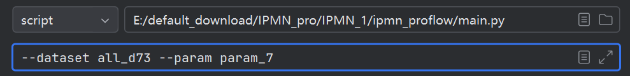
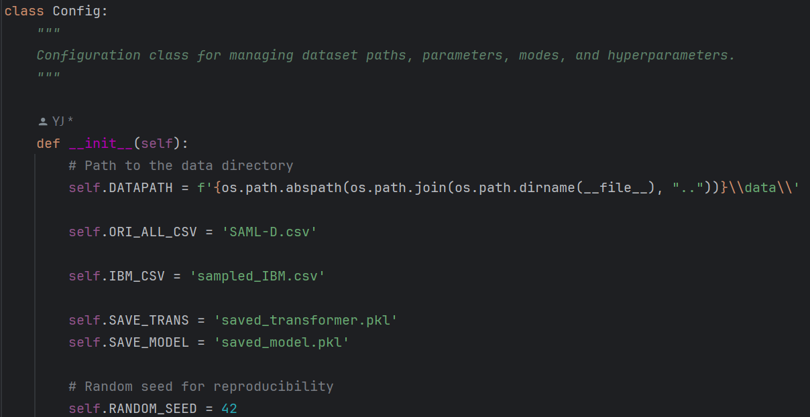
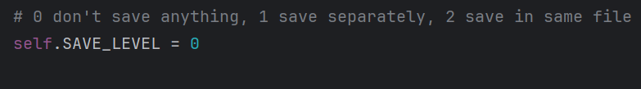
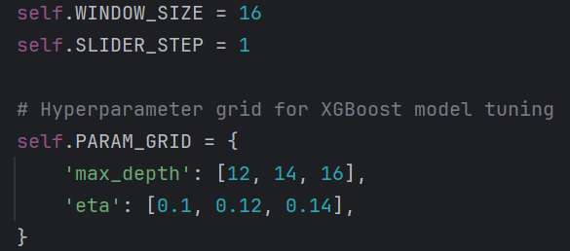
Just need simple config
command
Saving
Loading
Parameter setting

Slide 20
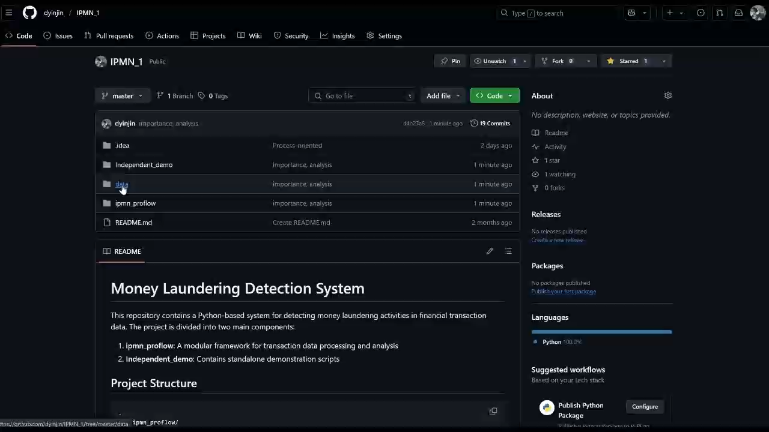

Slide 21
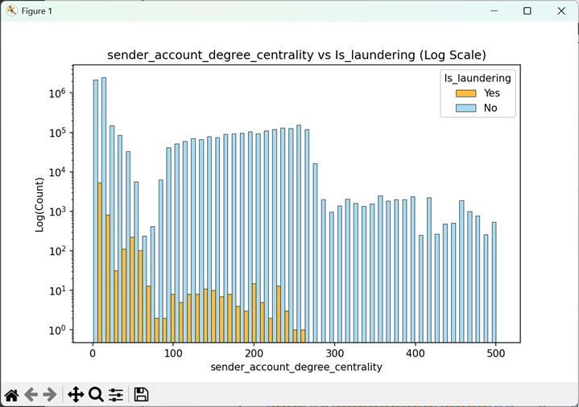
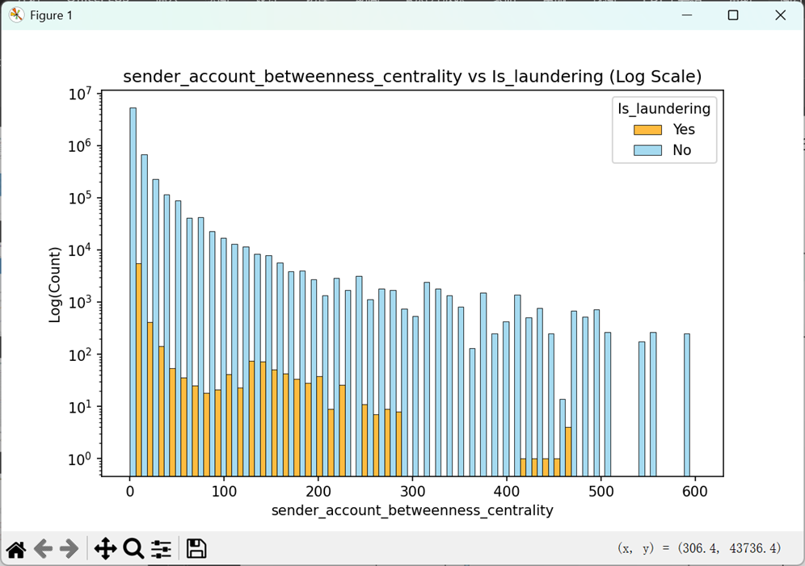
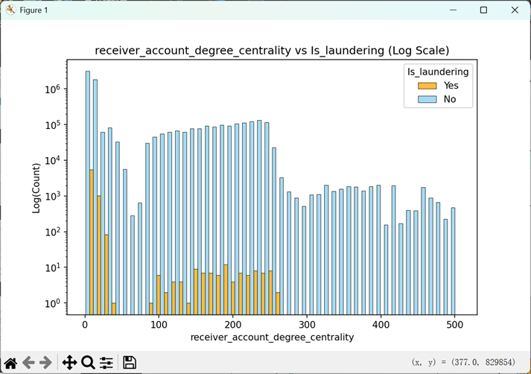
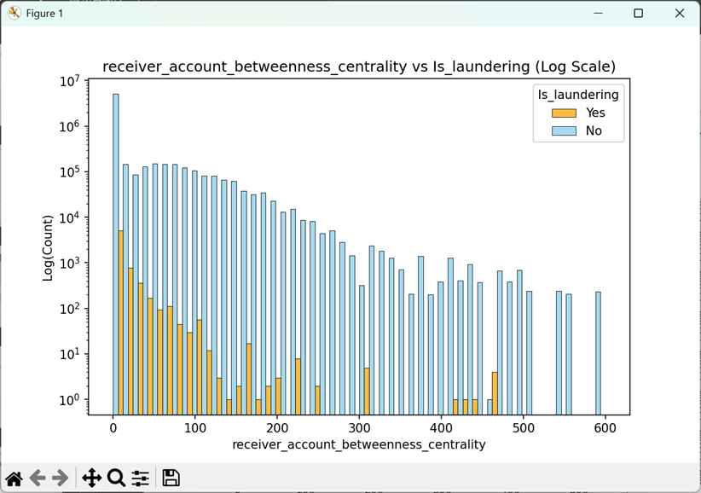
Interesting graph features: Areas with only a single color indicate that a clear distinction can be made here

Slide 22
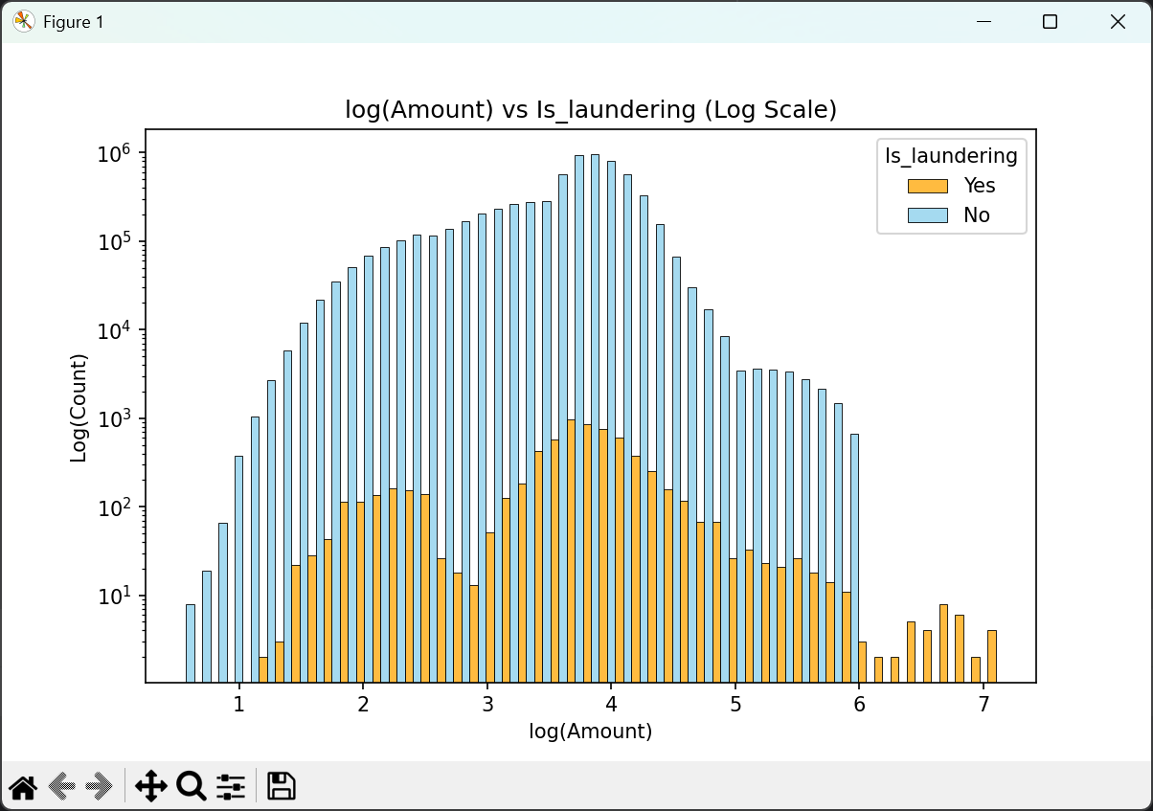
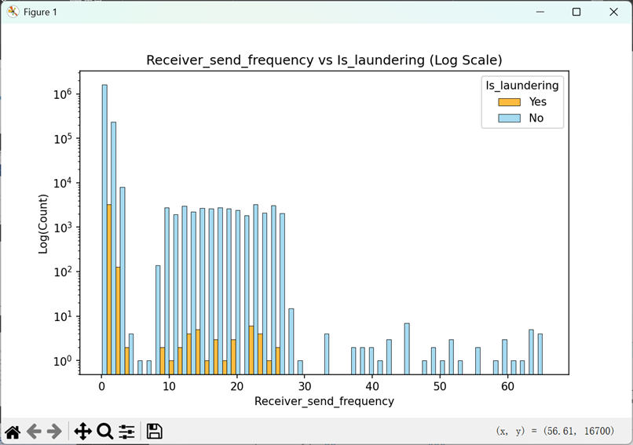
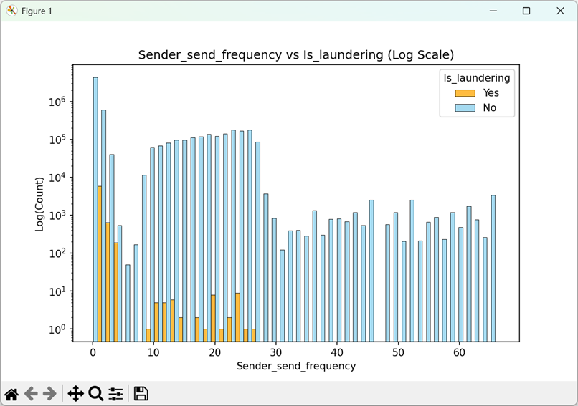
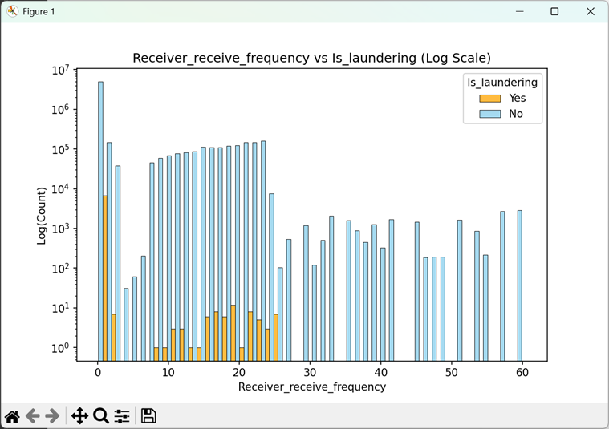
Some interesting basic features
Interesting

Slide 23
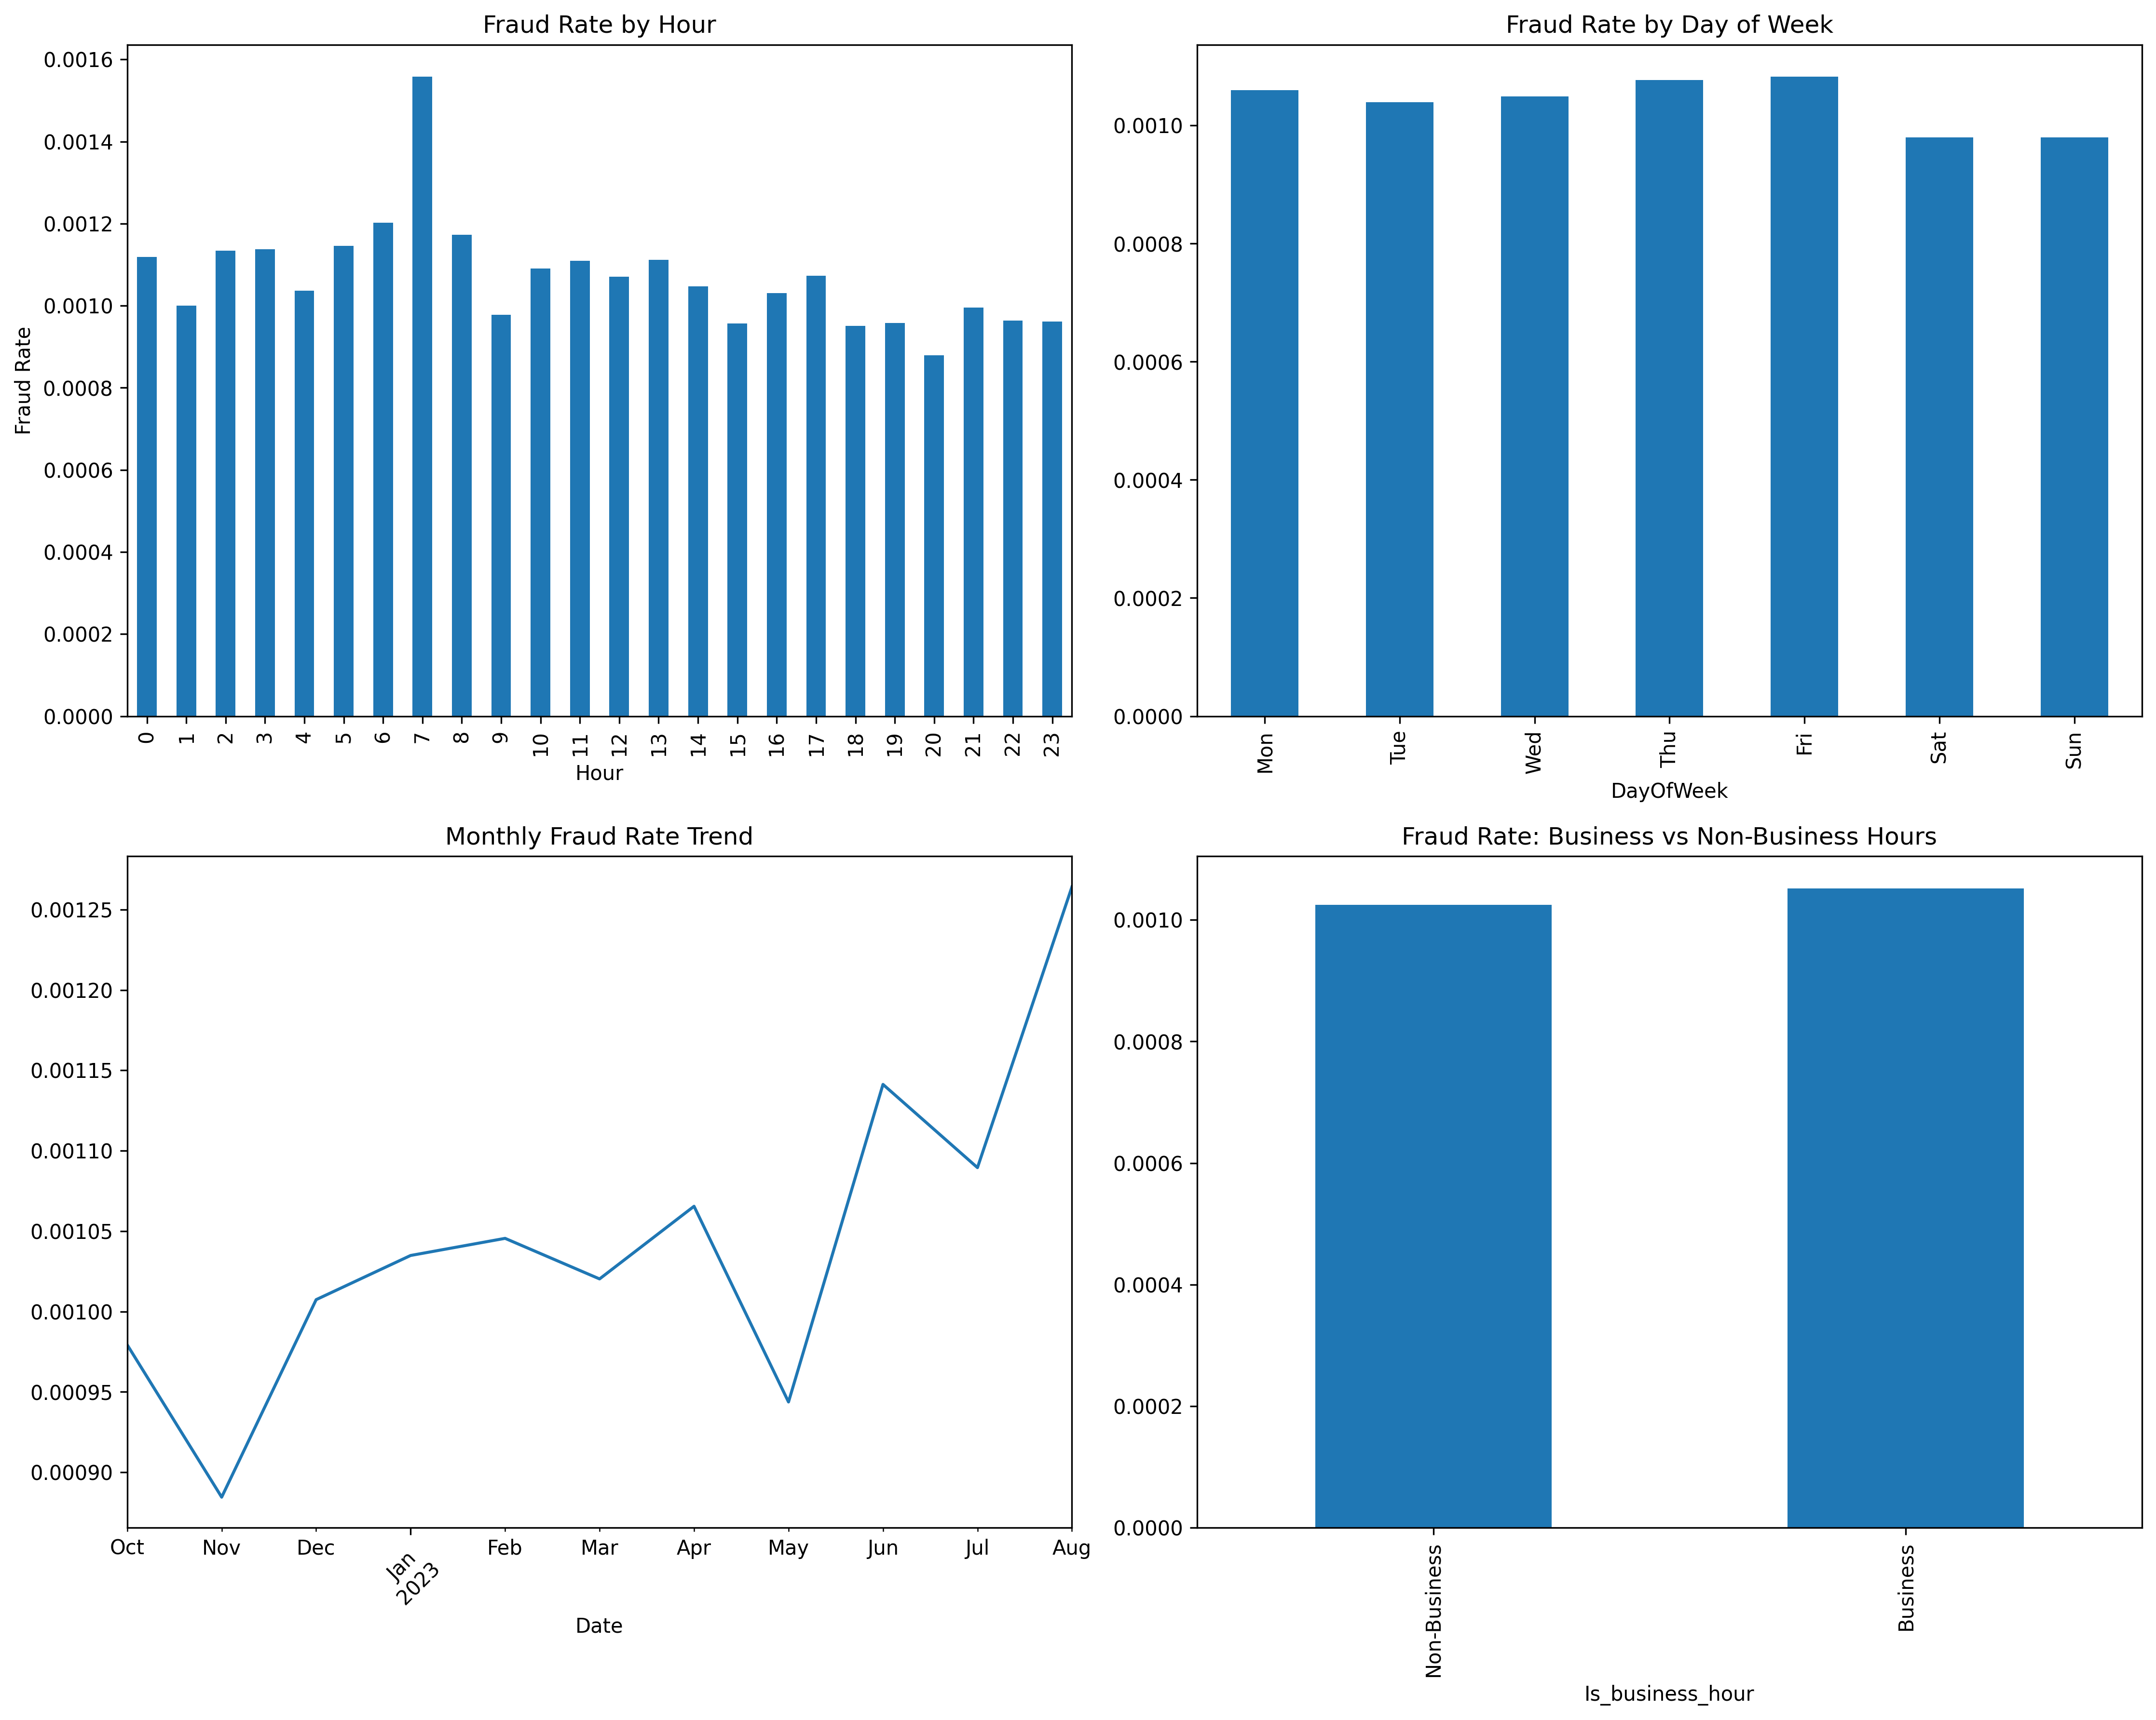
Interesting temporal patterns
Interesting

Slide 24
Machine learning can prioritize suspicious transactions to reduce manual screening scale
Is_laundering | predict_probability | High risk detect (set TPR=90%) | Middle risk detect (set TPR=95%) | Low risk detect (set TPR=99%)
0 | 0.000015 | 0 | 0 | 0
0 | 0.000530 | 0 | 0 | 0
0 | 0.007861 | 0 | 0 | 0
0 | 0.012601 | 0 | 0 | 1
1 | 0.083210 | 0 | 1 | 1
1 | 0.520030 | 1 | 1 | 1
1 | 0.750340 | 1 | 1 | 1
1 | 0.992970 | 1 | 1 | 1
Carefully select the threshold to find the top-n suspicious
Higher TPR will get high FPR, but will cover more instances of money laundering.
Lower TPR will result in fewer false positives, focusing on transactions with high laundering risks.

Slide 25
Machine learning can prioritize suspicious transactions to reduce manual screening costs
The model's score is given three levels: high risk, medium risk, and low risk
Reduce the scope of screening by filtering out only top-n highly rated cases to be screened as suspicious cases
Focus on high-risk, high-value due-diligence

Slide 26
Introduction of Past Work
Basic components
Performance & method
multi-classification model
Introduction of Future Work
Temporal Graph Network

Slide 27
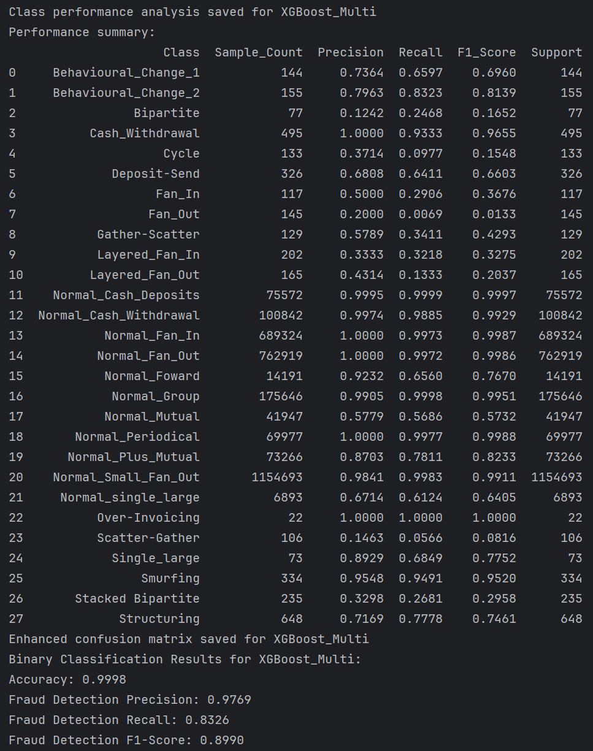
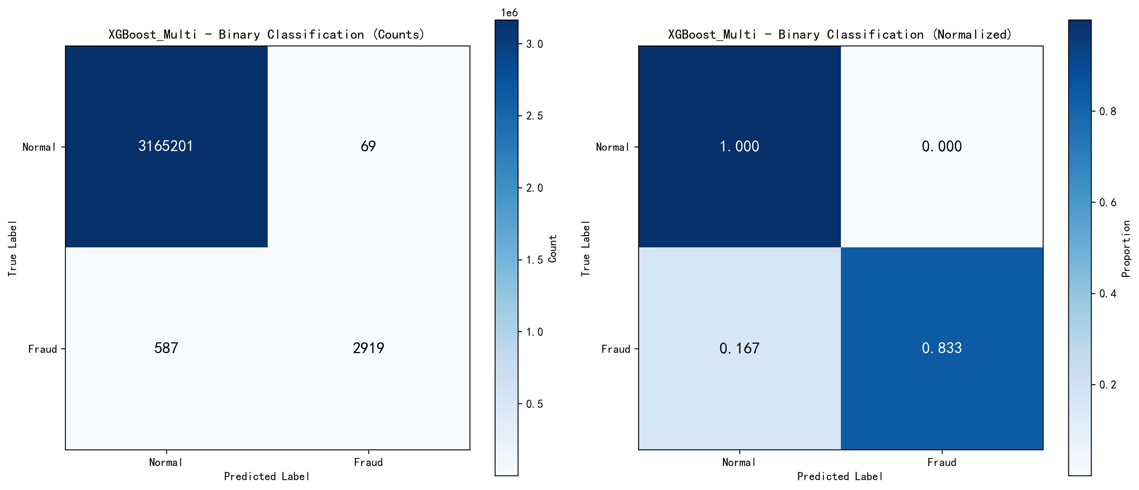
Our model can output predictions of AML types as explanations for detection
Given TPR = 83%
https://github.com/Yanuy/IPMN

Slide 28
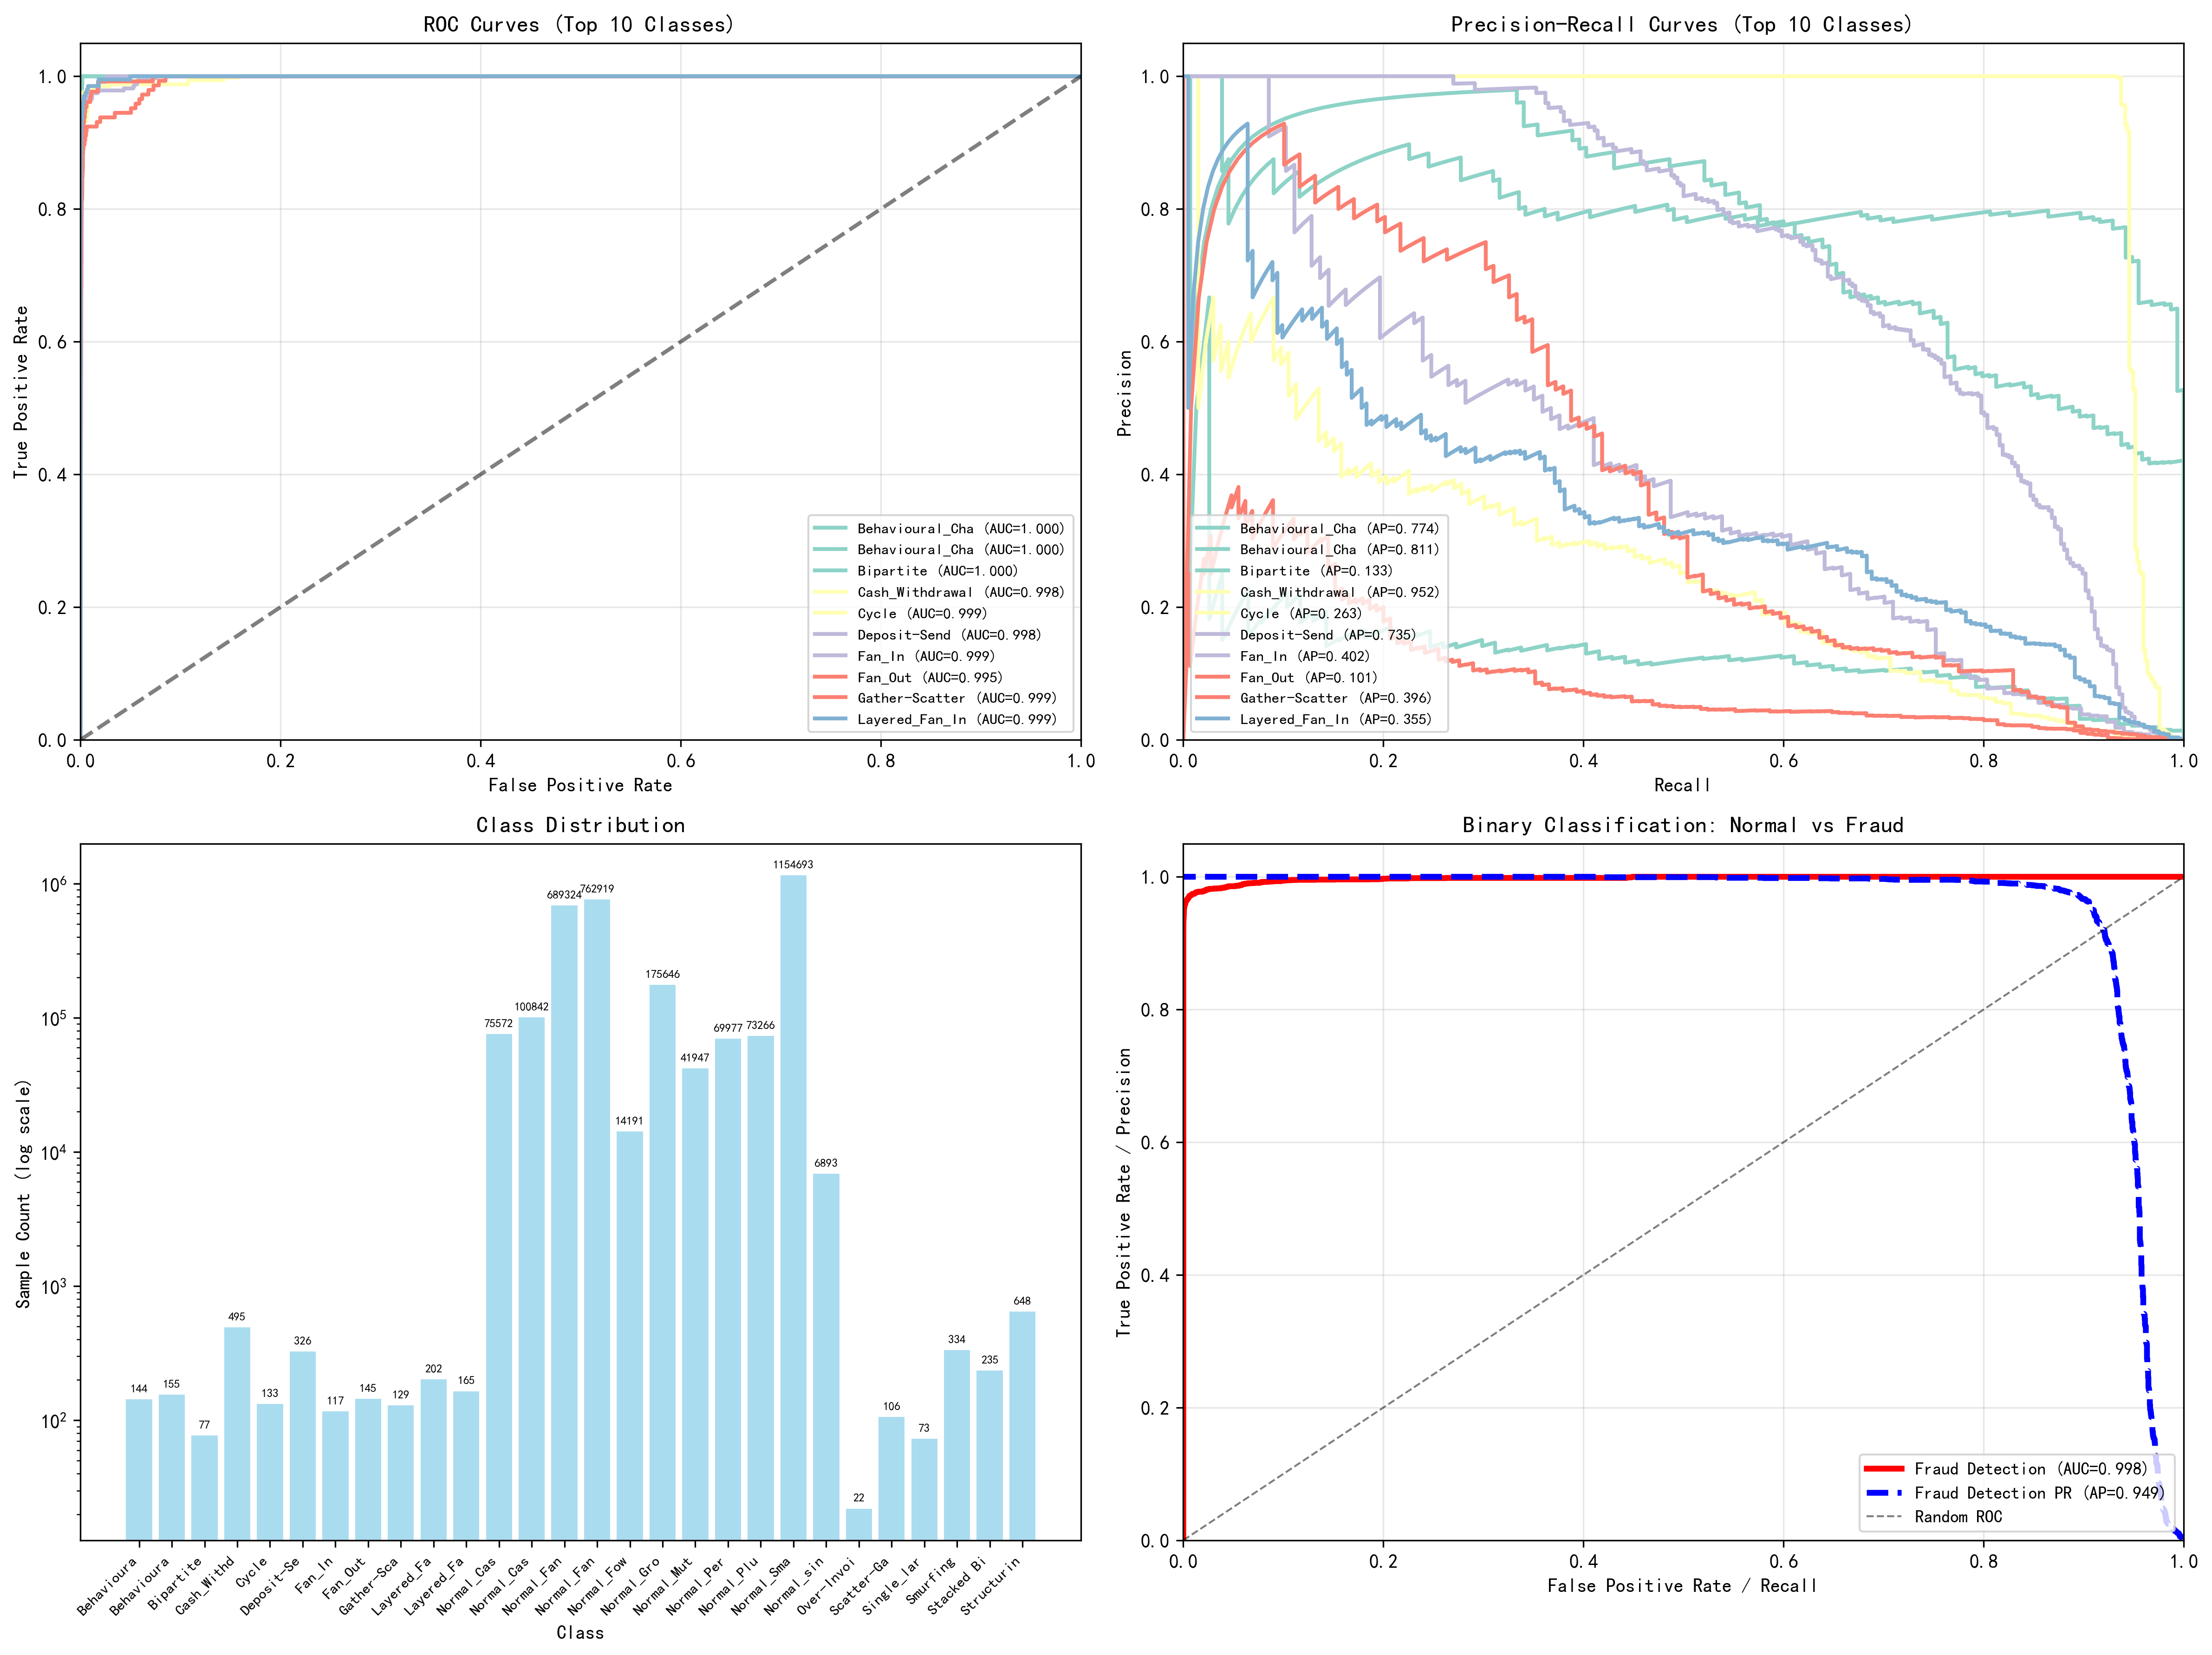
The multicategorization task shows us that the model has room for improvement for AML for Bipartite and Fan_out
Improving direction
Needs improvement

Slide 29
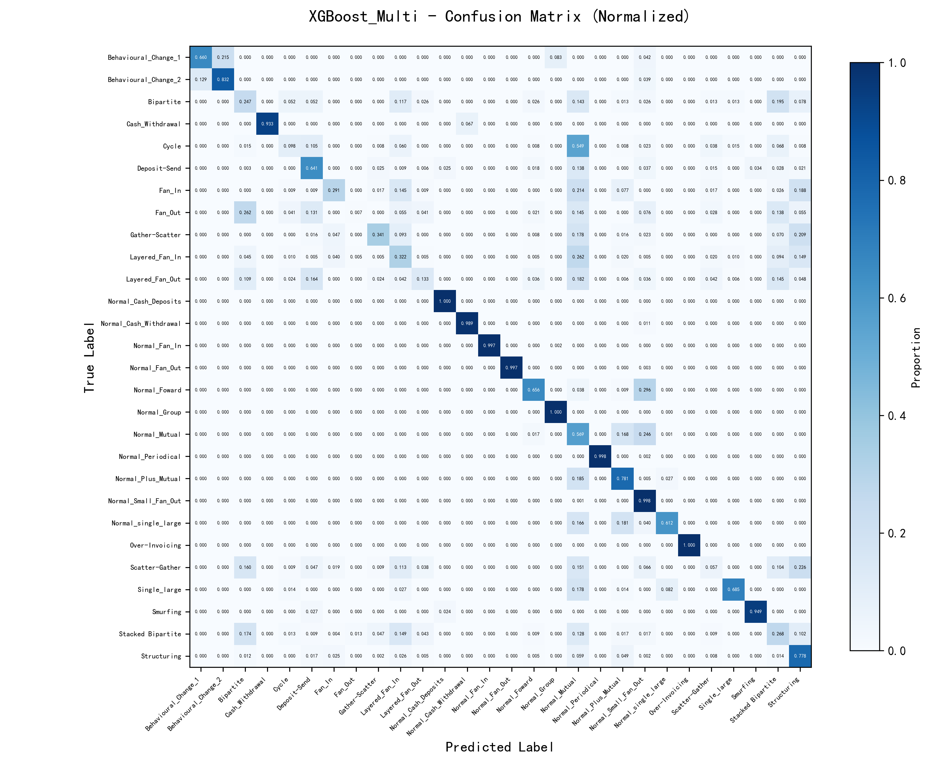
Not on the diagonal put a darker color indicates that the classification is less effective

Slide 30
Introduction of Past Work
Introduction of Future Work
Temporal Graph Network

Slide 31
Future Jobs
Model training | Feature engineering | Explainability | Automatization | Robustness
reset loss function to give higher attention to unbalanced classes | Time-frequency Feature + Amount Feature | Data provenance | TGN | Combined models(Random + Isolated forests + ANN)
 | Task-specific feature engineer enhancements based on performance on multi-categorical tasks | Sub-Mofits

Slide 32
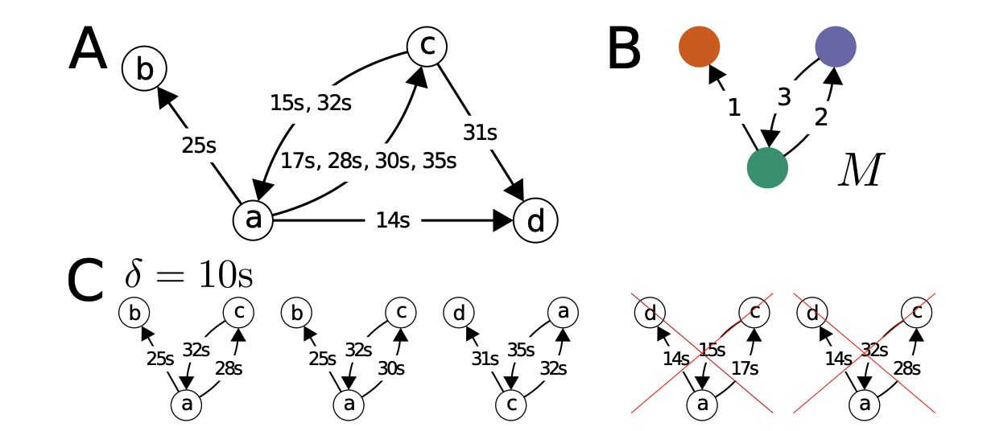
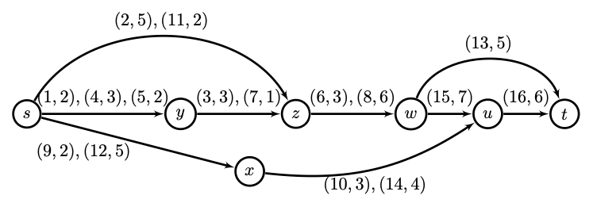
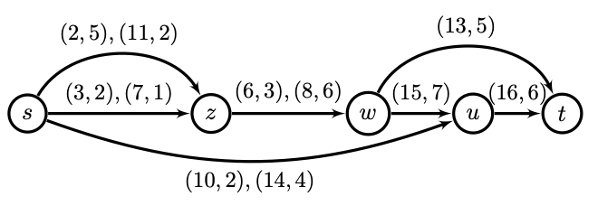
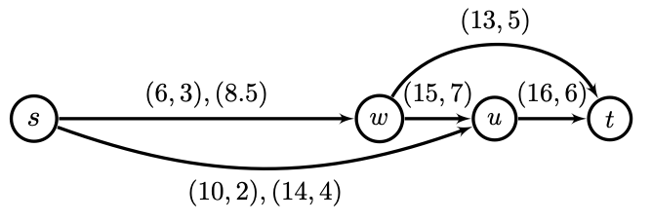
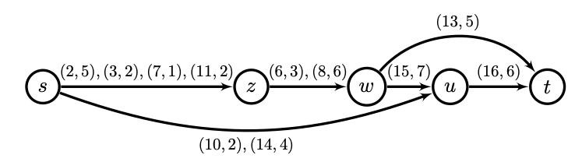
Sub-mofits & data provenance: Which flow is more prone to take money-laundering activity?
Preparation&simplification: used in AML of bitcoin

Slide 33
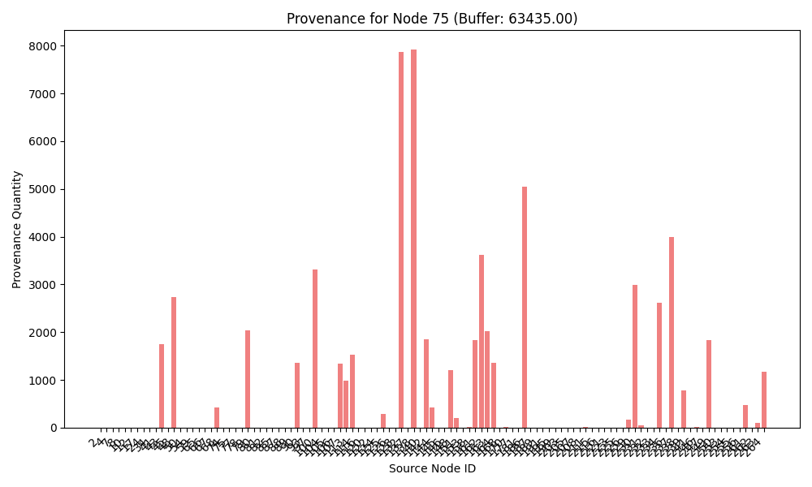
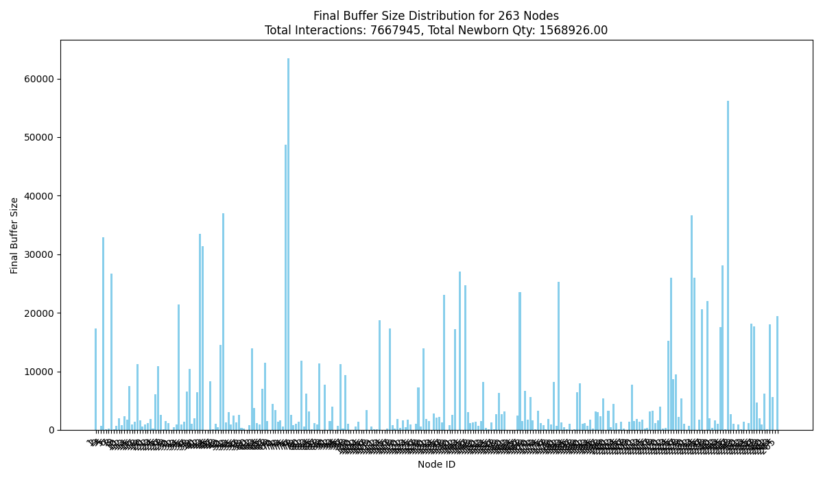
Sub-mofits & data provenance: How money flow runs in the network?

Slide 34


Is it possible to delegate the above steps to a single model completely?
What should I focus?
Manual feature engineering
Attention layer
Injecting information
Embedding
Short structure capture
Long memory space

Slide 35
Introduction of Past Work
Basic components
Performance & method
multi-classification model
Introduction of Future Work
Temporal Graph Network

Slide 36
Temporal graph network
A neural network method
which has the ability to detect the temporal traits of money laundering cases but less interpretability.
Rossi E, Chamberlain B, Frasca F, et al. Temporal graph networks for deep learning on dynamic graphs[J]. arXiv preprint arXiv:2006.10637, 2020.

Slide 37
Temporal graph network
Transactions can be modeled as a continuous-time dynamic graph:
Node: accounts
Link: transactions
A new transaction brings possible new nodes and a new link between two nodes with a timestamp.
Our task is to predict the probability of money laundering (or the probability of different money laundering types) for a new transaction.
Account i
Account j
Transaction n

Slide 38
Temporal graph network
Memory module
represent the node’s history in a compressed format (vector
Vector 1 (Account 1)
Vector 2 (Account 2)
Vector 3 (Account 3)
Vector 4 (Account 4)
…
Memory module

Slide 39
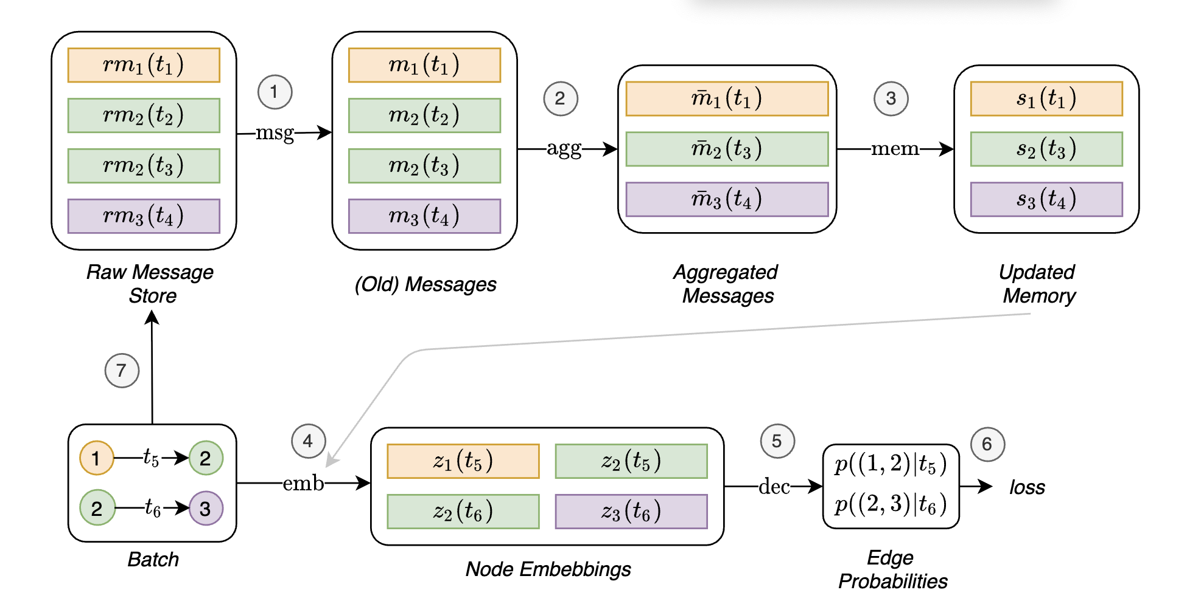
Model workflow
ml|t₅
ml|t₆
Money laundering probabilities

Slide 40
Model training workflow
ml|t₅
ml|t₆
Money laundering probabilities

Slide 41
Temporal graph network
The memory is updated continuously even after training reducing training frequency.
According its former application on social network dataset, one epoch with 200 events requires around 25 seconds.
The approximate size of the model would be less than 10GB assuming 200,000 accounts.

Slide 42
Q&A Thanks

